Slide 1

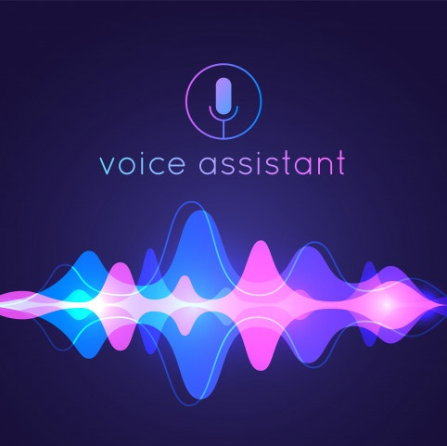
MINI-PROJECT Ai-Assistant Alicia
Second year computer engineering dept.
At PHCET

Slide 2




GROUP
Under the Guidance Of : Snehal Chitale Ma’am
SHIVAM RAJENDRA MODHAVE
RAJAT JAIPRAKASH RAI
ISHIKA SALIL RAIKAR
Aman rajendra sharma

Slide 3
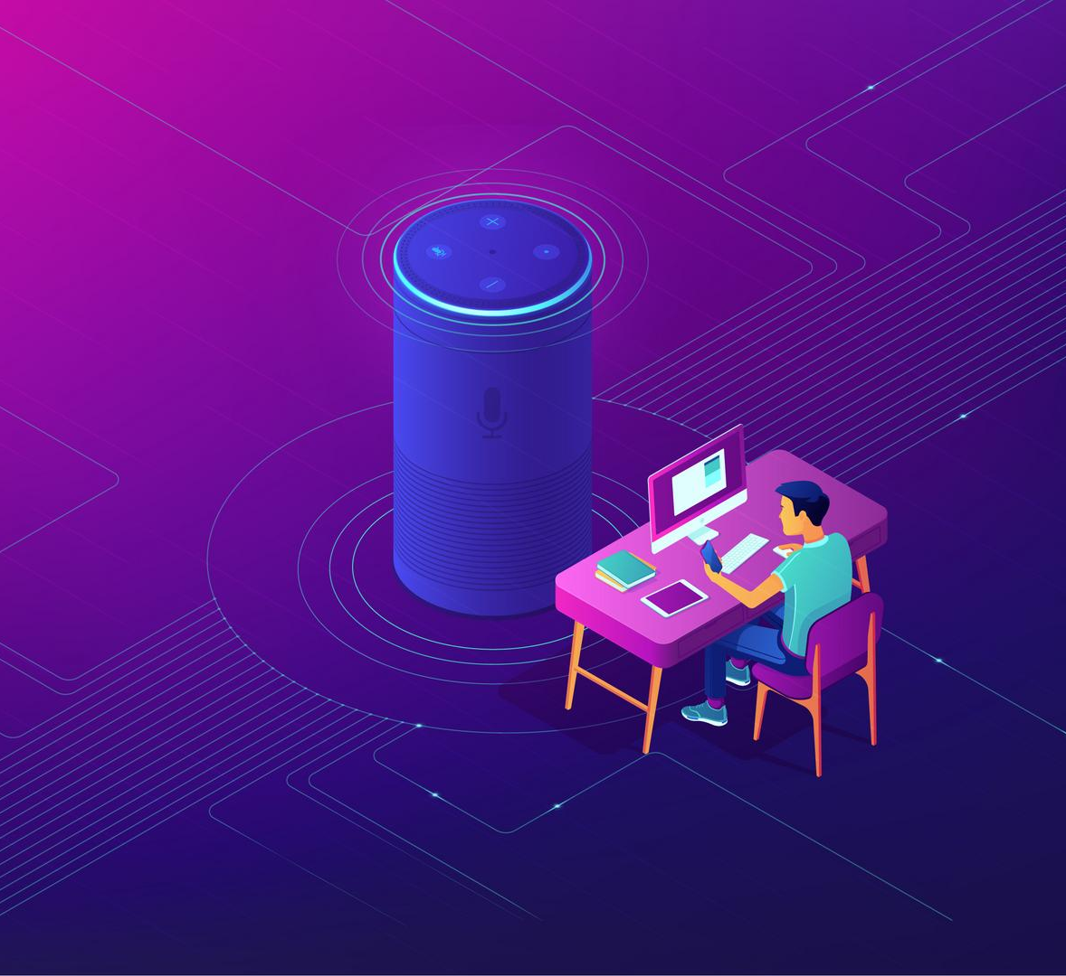
oVERVIEW
The main highlights of our topic which we are going to present is :
Importance of AI Assistant
Existing AI Assistant Systems
Literature Survey
Proposed System
Implementation of AI Assistant
Roadmap of Our Project
Features of Alicia

Slide 4
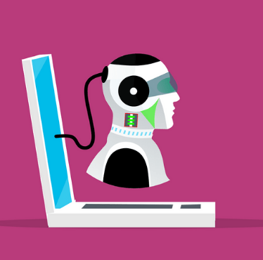


Importance of ai virtual assistant
IMPORTANCE
NEED
AI Virtual Assistant makes daily lives less chaotic.
Increases productivity
Offers 24/7 support, without the cost
Gets solutions to users query instantly
Faster, and easier way to perform everyday activities.
Understands what users really want and improve your product offering
Utilizes less time gives more result
Has vast scope in almost all the domain(Marketing ,stock , sports etc )

Slide 5



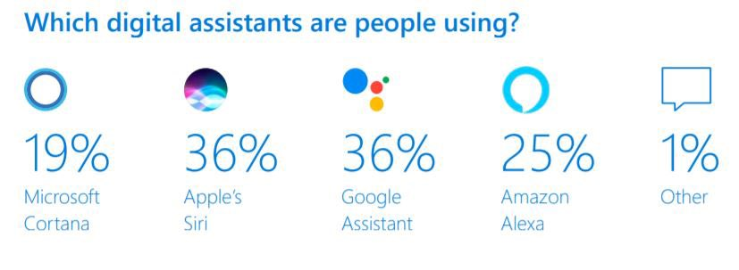
Existing ai assistants
GOOGLE ASSISTANT
Google Assistant is the most widely used assistant and it’s popularity is due to it’s compatibility with the countless number of hardware machines such as Mobile , TV , Smart speaker , Watch etc.
SIRI
Siri is the world’s most popular intelligent assistant. With SiriKit and Shortcuts, your apps can help users get things done with just their voice, intelligent suggestions, or the Shortcuts app. Your apps can also reach users across Apple platforms with Shortcuts on watchOS, SiriKit Music on HomePod, and SiriKit Media on Apple TV.
AMAZON ALEXA
Alexa is Amazon’s cloud-based voice service available on hundreds of millions of devices from Amazon and third-party device manufacturers. With Alexa, you can build natural voice experiences that offer customers a more intuitive way to interact with the technology they use everyday. We offer a collection of tools, APIs, to build alexa

Slide 6


LITERATURE SURVEY
Since the need of Computers is endless the scope for AI assistants is very diverse and nearly the future
According to various surveys the uses of AI is increasing on a large scale
Speech recognition has a long history with several waves of major innovations. Speech recognition for dictation, search, and voice commands has become a standard feature on smartphones and wearable devices.
Basic implementation of aI Virtual assistant
During the course of our Computer Engineering we came across various seminars and we got inspired by python and it’s vast Library support to language which sparked an idea in our minds to create a AI VIRTUAL ASSISTANT.
By studying more on this topic we developed our fundamentals in this project more and more from the sources such as geeksforgeeks ,Youtube , prerequisite of few related projects.
Also we went through various packages present on website https://pypi.org/ which forms forms the backbone of our project.
Advancements in ai assistants

Slide 7
Chart
Estimated No. of users of virtual assistant worldwide
1831 M
1642 M
1376 M
1016 M
710 M
504 M
390 M
In Millions
Source : Tractica LLC

Slide 8

Features of Alicia
Alicia Can perform all the tasks which is performed by other AI Assistants available.
Alicia is able to recognize the physical input as well as the voice command.
It supports Virtual Mouse , Virtual Keyboard , Voice typing , Face detection and many more exciting features which makes it special.
The future scope with Alicia is diverse
It will appear in GUI format .

Slide 9


PROPOSED system features
CORTANA
ALICIA
Can open softwares present in system on command
Cannot Recognize physical inputs
Performs and shows results using web search
Does not supports AI virtual Mouse , keyboard , Face detection features.
Can open softwares present in system on command
Can Recognize physical inputs
Performs and shows results using web search
Supports AI virtual Mouse , keyboard , Face detection features.

Slide 10

Roadmap to ALICIA
All the basic AI Virtual Assistant Features
Face Detection
Voice Typing on command
1
3
5
2
4
6
AI Virtual Mouse
Integration
AI Virtual Keyboard integration
Virtual Quiz Game, QR Code Generator , Canvas Painting and enhanced system

Slide 11
Implementation
We are going to use python language for our project.
IDE used in this is VS Code and Pycharm.
First we are going to implement our AI virtual assistant basic Functionalities such as responding to user, web searching etc.
After assistant can listen and respond we are going to integrate a AI virtual Mouse feature which can be enabled using voice command.
Later on we introduced features such as virtual keyboard and face detection which can be enabled on command. We are implementing this using python libraries.
Further we have added Air canvas , QR Code Generator , Virtual Games such as rock paper scissor , Snake and ladder Quiz Game etc
AI Basic Commands
Virtual Mouse
Face Detection
Virtual Keyboard
Voice Typing
Core Features
ALICIA

Slide 12

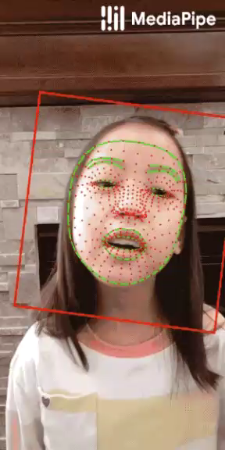
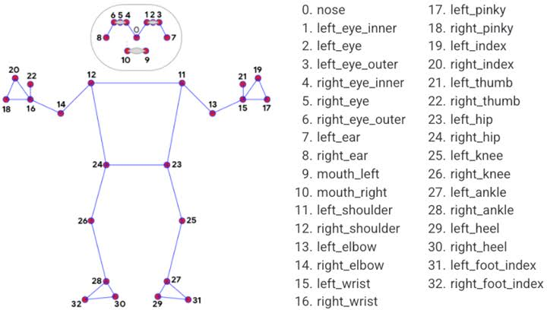
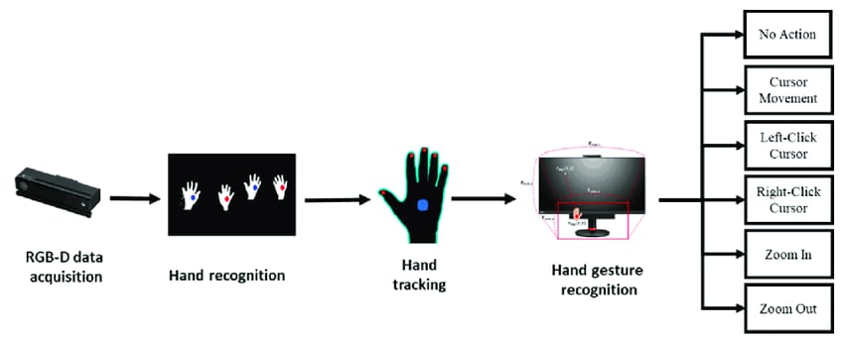
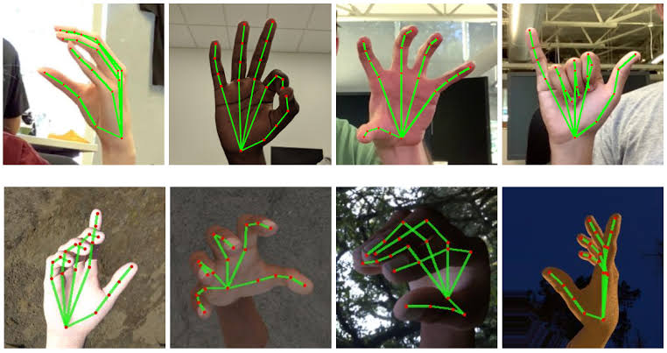
-

Slide 13
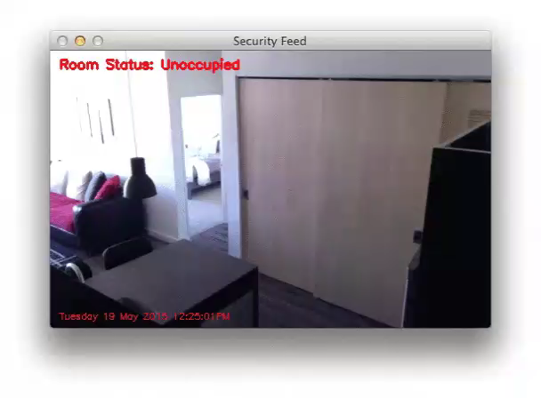
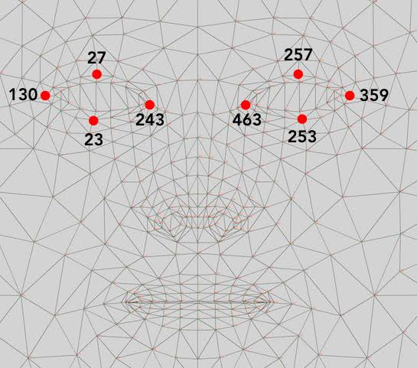
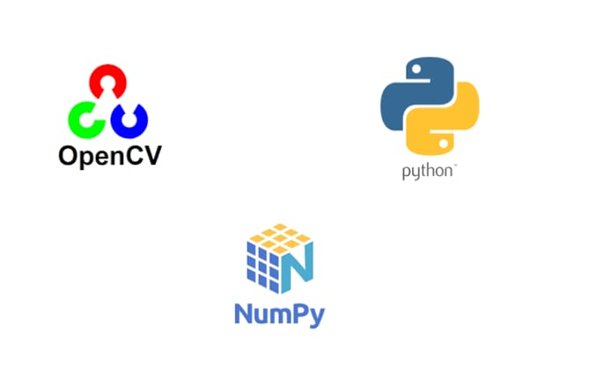

-
OPENCV

Slide 14
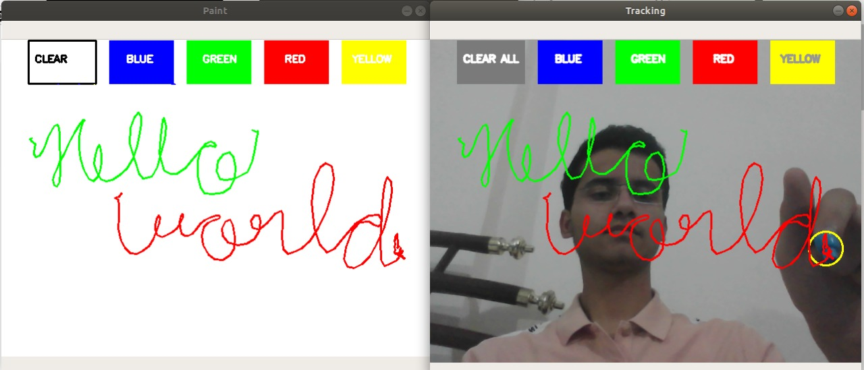
Air canvas
Air Canvas which can draw anything on it by just capturing the motion of a coloured marker with a camera.
Colour Detection and tracking features in OpenCV are used in order to achieve the objective.
The colour marker is detected and a mask is produced
It includes the further steps of morphological operations on the mask produced which are Erosion and Dilation.

Slide 15
Virtual quiz games
Snake Game is one of the traditional 2D game
Player has to make sure that snake do not hit the walls or shouldn’t collide in itself. Player can control the snake with Right, Left, Bottom, Top keys.
There is an object on the screen referred to as ‘food’. Every time snake collides with the food, the food disappears and snake body size is increases.
There is a score for every successful collision of snake with the food.
This game is build using tkinter and random module
Rock-Paper-Scissors Game
The object of the rock-paper-scissor python project is to build a game for a single player that plays with a computer, anywhere, and anytime. This project is base on the rules that:
rock blunts scissors so rock wins
scissors cut the paper so scissors win
paper cover rock so paper wins
This game is build using ASCII art and random modules, and the basic concept of python.
Snake Game
Python

Slide 16
Qr code generator
QR Code Generator generates a QR Code for the Respective Pages.
It asks users about the website and name to save the QR code.
This QR code can be scanned by any scanner and the end user will be prompted to the respective Url.
QR code generator eliminates the need of sharing complex links among users.
This uses two modules QR module and speech_recognition module.
QR code module accepts the URLs as inputs and generates the QR code for the respective Website
Speech Recognition module helps to take the voice inputs which makes entire process hands free and effective

Slide 17
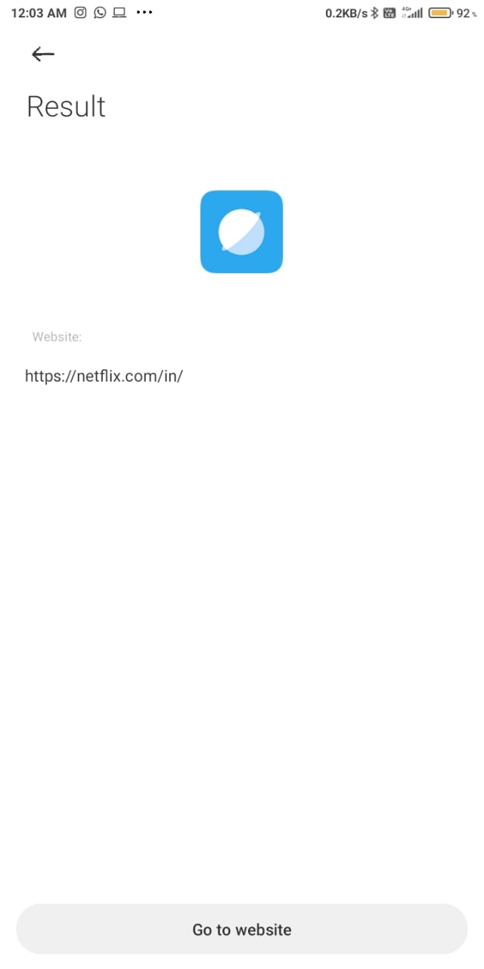
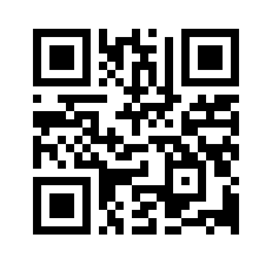
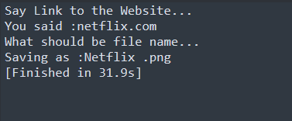
Example of qr code generator

Slide 18
Advantages OF ALICIA OVER EXISTING SYSTEMS:
Alicia can recognize the user by their face which is not available in any of the current AI assistant which helps to increase the security of Alicia
Apart from voice input Alicia can also understand the hand gestures of the end user
Because of the implementation of OpenCV Scope with Alicia is Diverse
Alicia contains lots of fun features which helps to increase the engagement of the end user ( Games , Jokes , Roll a Dice , Flip a Coin)
Alicia can be very useful as a desktop assistant which can perform much handy operations within a snap of time.

Slide 19
Limitations OF ALICIA OVER EXISTING SYSTEMS:
Alicia is not available in app format yet.
Security is limited upto face detection
Sometimes it struggles in voice recognition.
It cannot memorize dates and events like other assistants.
Virtual mouse works only in good lighting conditions.
It cannot operate the home appliances.
It doesn’t supports multiple Language Support till now.

Slide 20
Result and Conclusion
RESULT :
We have created a complete desktop based AI Assistant which was necessary as there is no already established assistant available for the desktop . Alicia can overcome those limitations and provide a smooth and intelligent interface to the user .
CONCLUSION :
ALICIA is a very helpful voice assistant without any doubt as it saves time of the user by conversational interactions, its effectiveness and efficiency.
The users of ALICIA feel secure while using because it is protected with face security camera. Hence these concepts make ALICIA to look different and unique in front of the other virtual assistants.

Slide 21

Thank you!
Flora@contoso.com
http://www.contoso.com/

